Slide 1
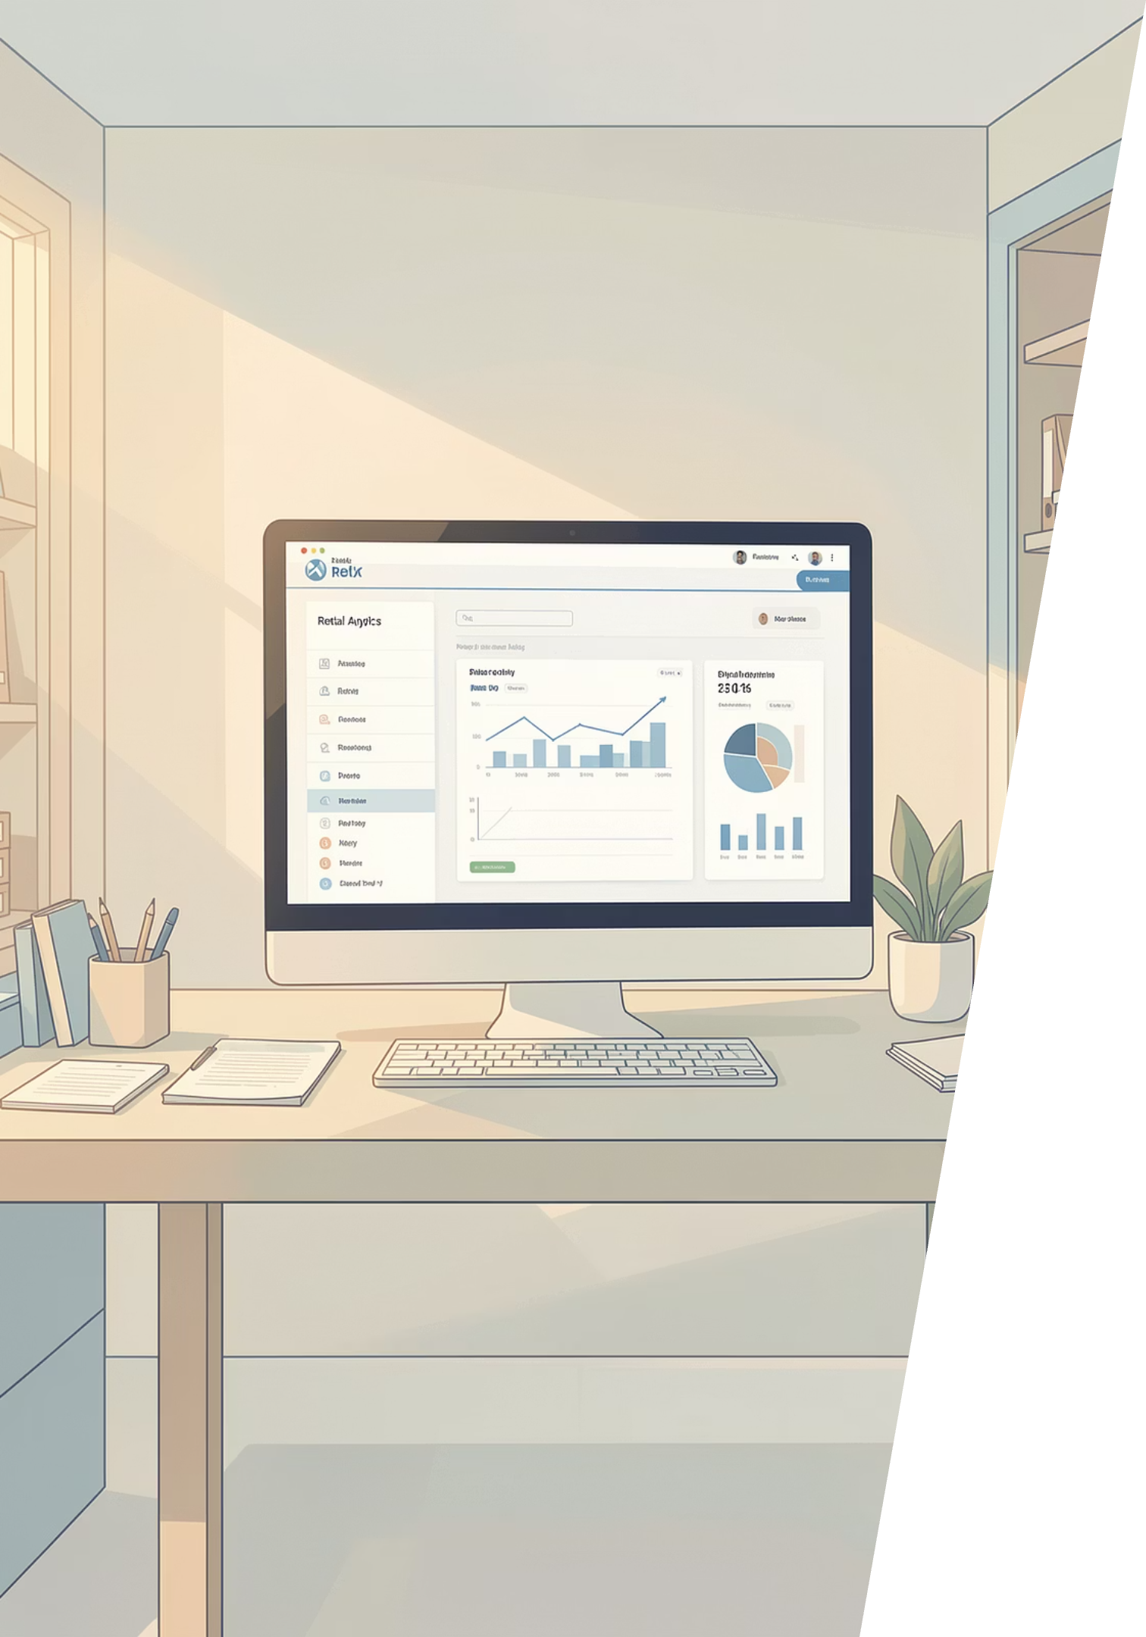
Customer Shopping Behavior Analysis
Analysis of 3,900 purchases to uncover spending patterns, segments, product preferences, and subscription behavior to inform strategic decisions.

Slide 2
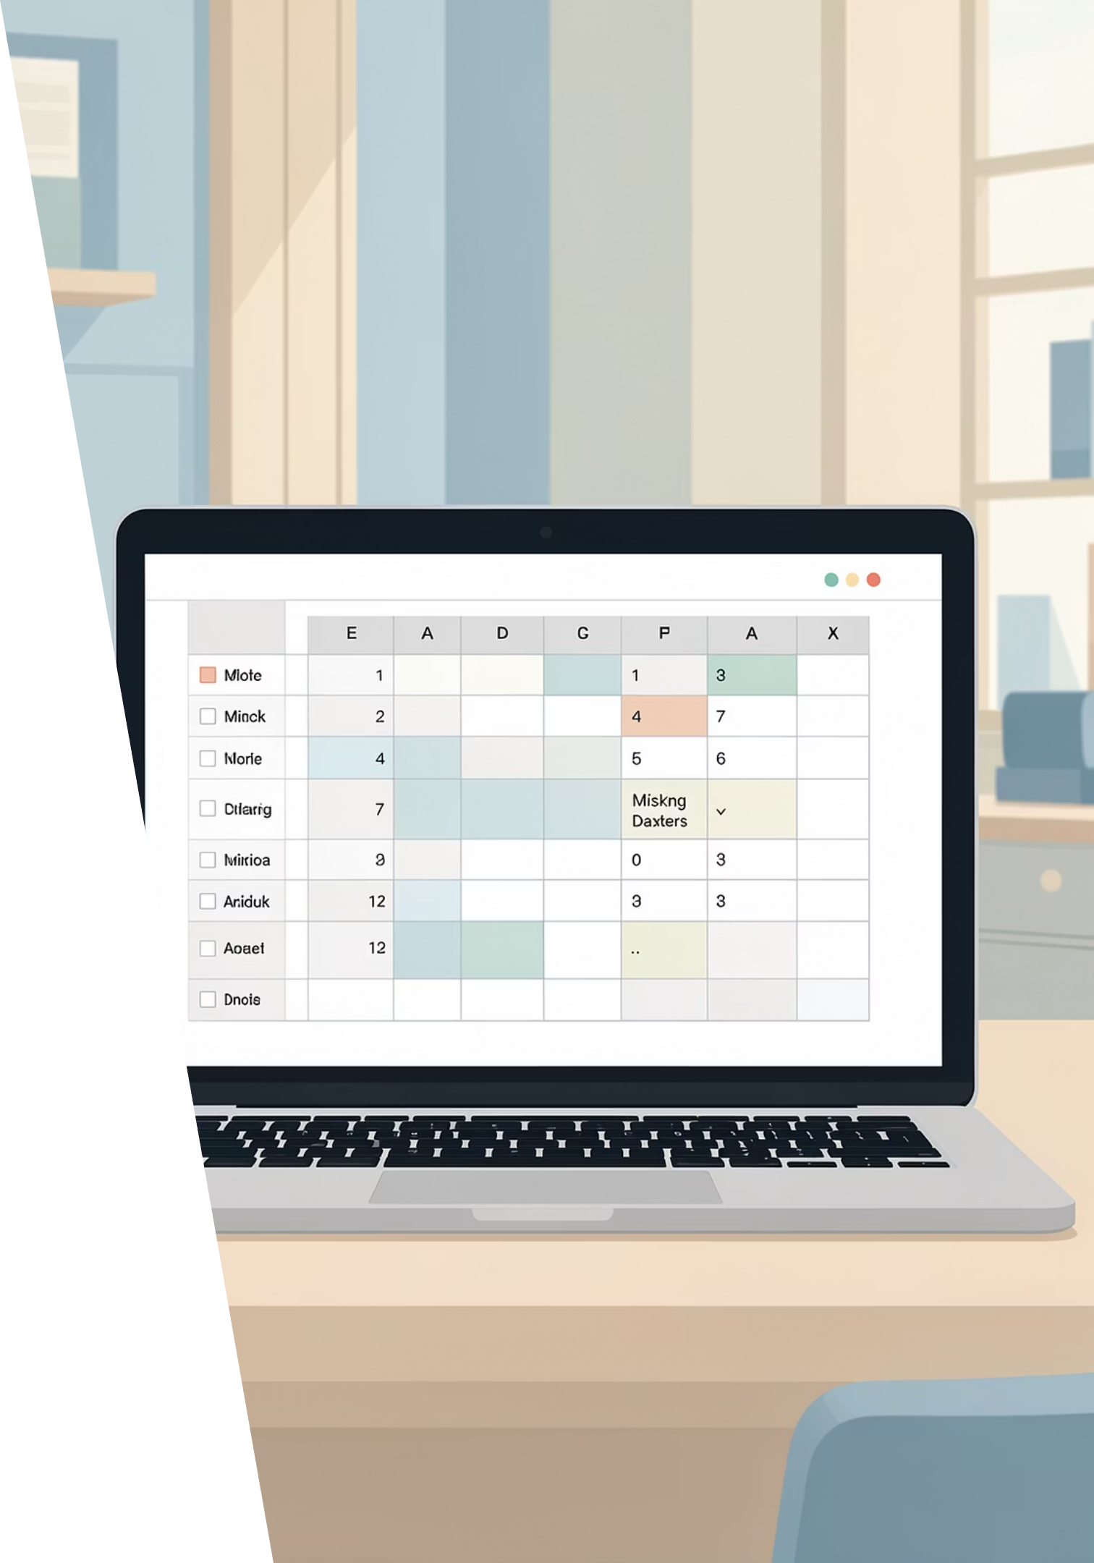
Dataset Summary
Scope
Key Features
Data Quality
3,900 rows × 18 columns covering demographics, purchases, shipping, and reviews.
Age, Gender, Location, Item, Category, Purchase Amount, Season, Subscription Status, Shipping Type, Review Rating.
Missing: 37 values in Review Rating column; handled via imputation.

Slide 3

Data Preparation & Feature Engineering
Loaded data with pandas; inspected structure (df.info) and stats (.describe).
Imputed Review Rating using category median.
Renamed columns to snake_case and dropped redundant promo_code_used.
Created age_group and purchase_frequency_days features.

Slide 4

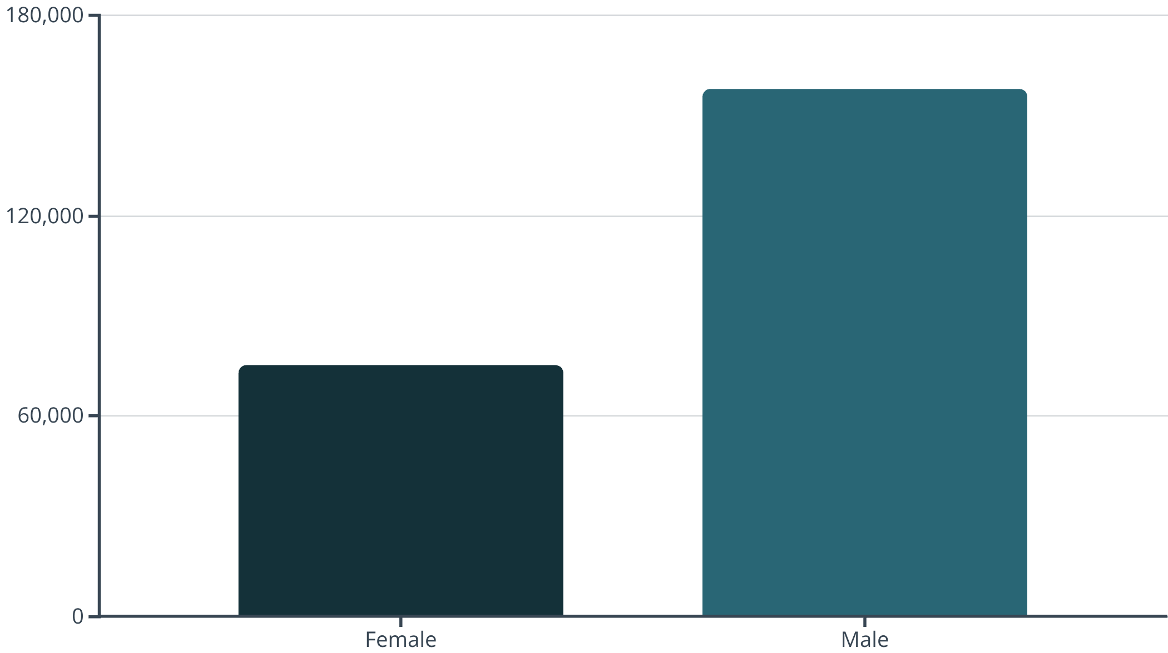
SQL Analysis — Revenue & Segments
Male customers generated higher total revenue than female customers in this dataset.

Slide 5



Top Products & Discount Dependence
Gloves
Sandals
Hat
Top rated (avg 3.86).
High rating (3.84) and top footwear seller.
Top 5 by rating (3.80) and highest discount rate (50%).
Other high discount-rate products: Sneakers (49.66%), Coat (49.07%), Sweater (48.17%), Pants (47.37%).

Slide 6
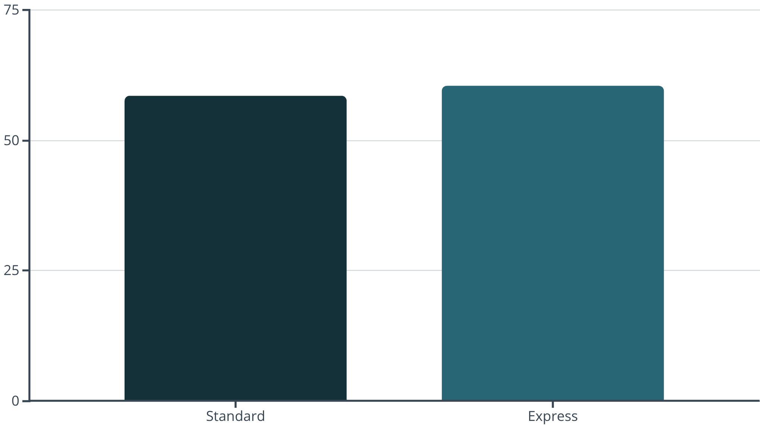

Shipping & Purchase Amounts
Express shipping purchases average slightly higher than Standard. Consider shipping-based promotions for upsell.

Slide 7

Customer Segmentation & Loyalty
Loyal
3,116 customers — primary repeat buyer group.
Returning
701 customers.
New
83 customers — opportunity for conversion.

Slide 8
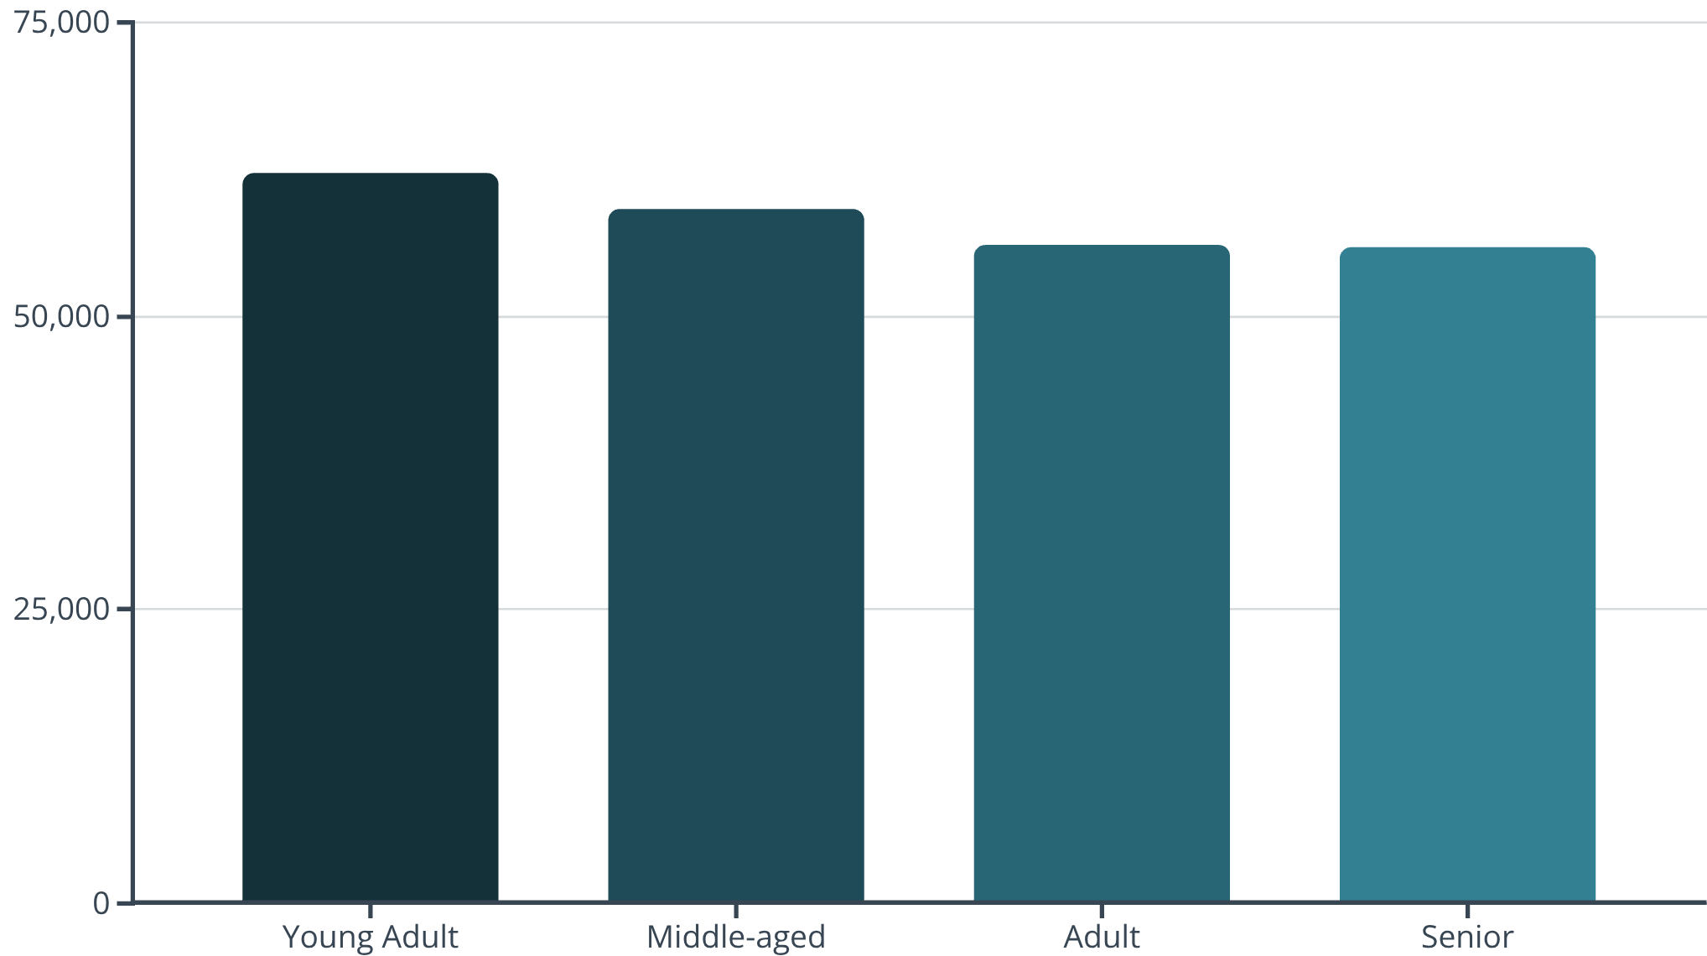

Age Group Revenue & Sales
Young adults contribute the most revenue. Sales volume also skews toward younger groups (Young Adult highest orders).

Slide 9
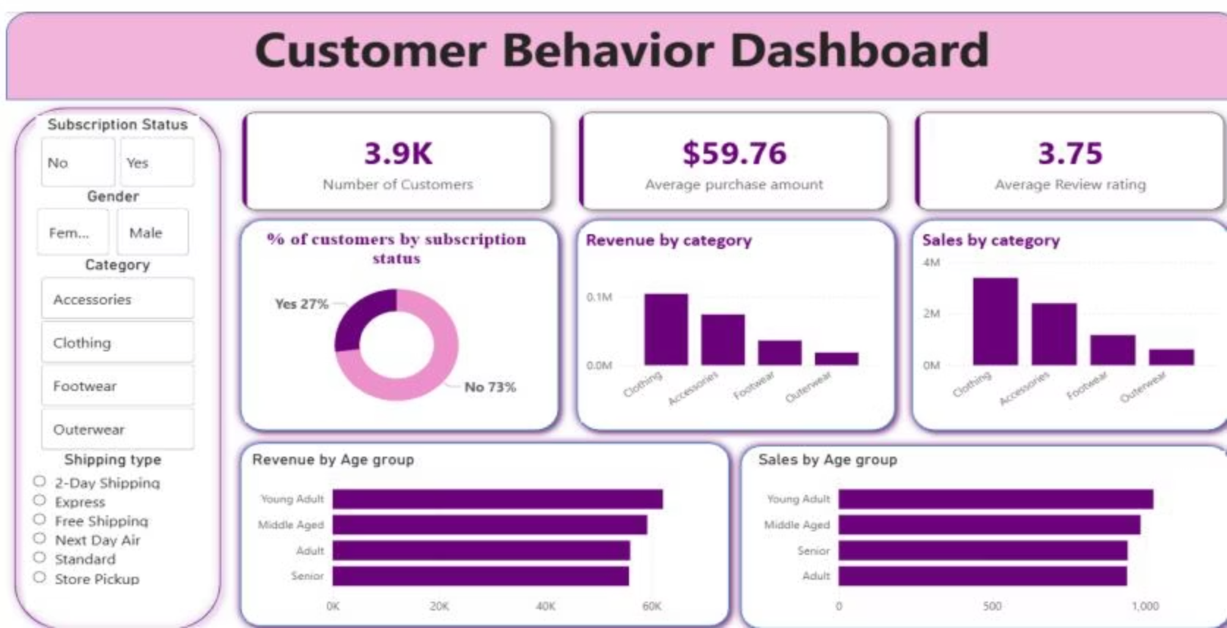
Power BI Dashboard Highlights
Interactive dashboard shows: 3.9K customers, $59.76 average purchase, 3.75 avg review rating, subscription split Yes 27% / No 73%, revenue & sales by category and age group.

Slide 10
Business Recommendations
Boost Subscriptions
Reward Loyalty
Review Discounts
Product Positioning
Implement programs targeting repeat buyers to solidify the Loyal segment.
Rebalance discount strategy to protect margins while maintaining sales.
Promote exclusive benefits to increase subscriber base and lifetime value.
Feature top-rated and best-selling items in campaigns to drive conversion.
Targeted Marketing
Focus on high-revenue age groups and express-shipping customers for tailored offers.

